Slide 1
HEART_
MAKER/BREAKER
ADNAN, ISABEL, KRIS, MING-CHI, LANCE
AASD 4001 TERM PROJECT

Slide 2
INTRODUCE DATASET
EDA SNIPPETS
DATA PREPROCESSING
HYPOTHESIS
APPROACH
TUNED MODELS
LOGISTIC REGRESSION
DECISION TREE
RANDOM FOREST
SGD
SVM
FEATURE REMOVAL
REVIEW REFINED MODEL PERFORMANCE
NEXT STEPS
01
02
03
04

Slide 3
10000 rows × 21 columns
Numeric Features
['Age', 'Blood Pressure', 'Cholesterol Level', 'BMI', 'Sleep Hours', 'Triglyceride Level', 'Fasting Blood Sugar', 'CRP Level', 'Homocysteine Level']
Categorical Features
['Gender', 'Exercise Habits', 'Smoking', 'Family Heart Disease', 'Diabetes', 'High Blood Pressure', 'Low HDL Cholesterol', 'High LDL Cholesterol', 'Alcohol Consumption', 'Stress Level', 'Sugar Consumption’]
Label (Imbalanced)
Heart Disease Status:
'No': 8000 (80.00%)
'Yes': 2000 (20.00%)
Which ML approaches fits our disease prediction problem the best?
Hypothesis:
Likely between Random Forest (often best overall fit: handles mixed data & captures non-linear interactions well),
Logistic Regression (clinical benchmark: high interpretability), and
SVM (best for high-dimensional clean data: excellent for complex biomarker data)
Approach:
Obtain understanding of dataset, EDA
Preprocess data, columns to drop, fill missing values
Split train/test data, stratify=Yes
Run baseline models & tune hyperparameters, GridSearchCV
Assess tuned models for each approach, recall
Have fun, feature ablation
INTRODUCE DATASET
HYPOTHESIS
APPROACH
EDA SNIPPETS
DATA PREPROCESSING
01

Slide 4
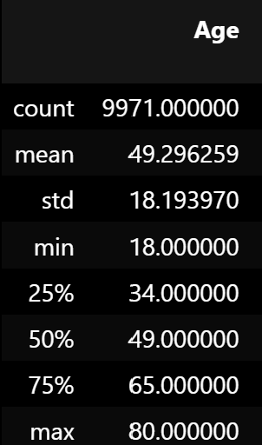
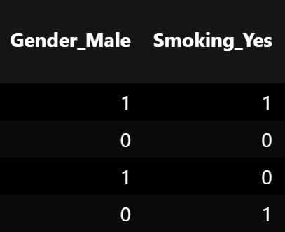
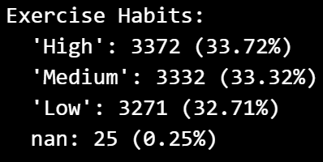
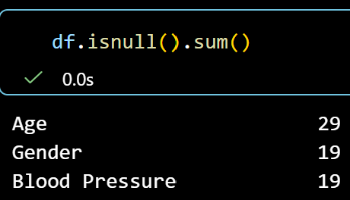
INTRODUCE DATASET
HYPOTHESIS
APPROACH
EDA SNIPPETS
DATA PREPROCESSING
# Fill NaN values in numeric columns using median
for col in numeric_columns:
df[col] = df[col].fillna(df[col].median())
df = df.drop([
'Exercise Habits',
'Alcohol Consumption',
'Stress Level',
'Sleep Hours',
'Sugar Consumption'
], axis=1)
01

Slide 5
Accuracy: 52.25%
Class 0 → P: 0.80 | R: 0.54 | F1: 0.64
Class 1 → P: 0.20 | R: 0.46 | F1: 0.28
TUNED MODELS
LOGISTIC REGRESSION
DECISION TREE
RANDOM FOREST
SGD
SVM
Baseline model established
Highlighted poor detection of the positive class.
Applied hyperparameter tuning
Used GridSearchCV
            Cross-Validation and
            Class_weight='balanced
            Tuning produced almost no change in performance.
            Heart disease recall remained approximately 46%.
After Tuning
Accuracy: 52.20%
Class 0 → P: 0.80 | R: 0.54 | F1: 0.64
Class 1 → P: 0.20 | R: 0.46 | F1: 0.28
02

Slide 6
TUNED MODELS
LOGISTIC REGRESSION
DECISION TREE
RANDOM FOREST
SGD
SVM
Removed selected features
Smoking
Diabetes
Evaluated effect of feature reduction on model performance
Compared results before and after removal
Removing features reduced recall from 46% to 43%.
After removing selected features
Removed Features:’Smoking_Yes', ‘Diabetes_Yes'
Accuracy: 0.514
precision recall f1-score support
0 0.79 0.53 0.64 1600
1 0.19 0.43 0.26 400
accuracy 0.51 2000
macro avg 0.49 0.48 0.45 2000
weighted avg 0.67 0.51 0.56 2000
02

Slide 7
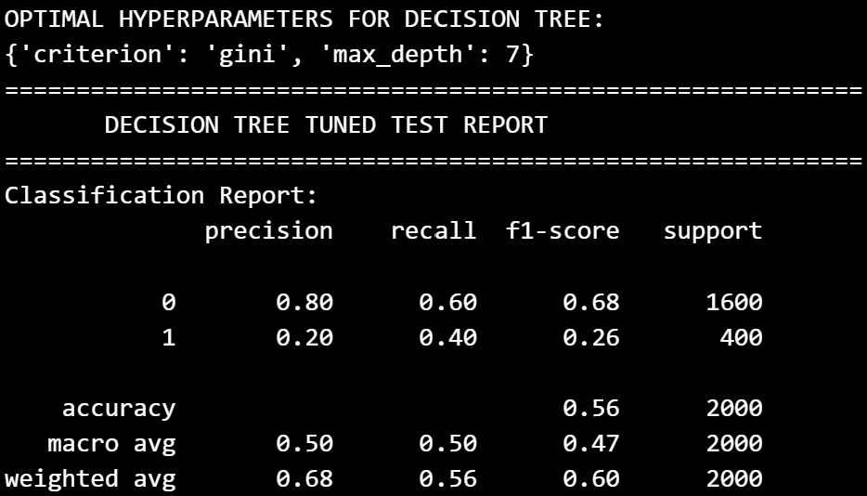
TUNED MODELS
LOGISTIC REGRESSION
DECISION TREE
RANDOM FOREST
SGD
SVM
grid_search = GridSearchCV(
estimator=base_dt,
param_grid=param_grid,
scoring='recall', # Discussed this for our medical diagnosis context
cv=5,
n_jobs=-1
)
base_dt = DecisionTreeClassifier(random_state=42,class_weight='balanced')
02
param_grid = {
'max_depth': [3, 5, 7, 10, None],
'criterion': ['gini', 'entropy']
}

Slide 8
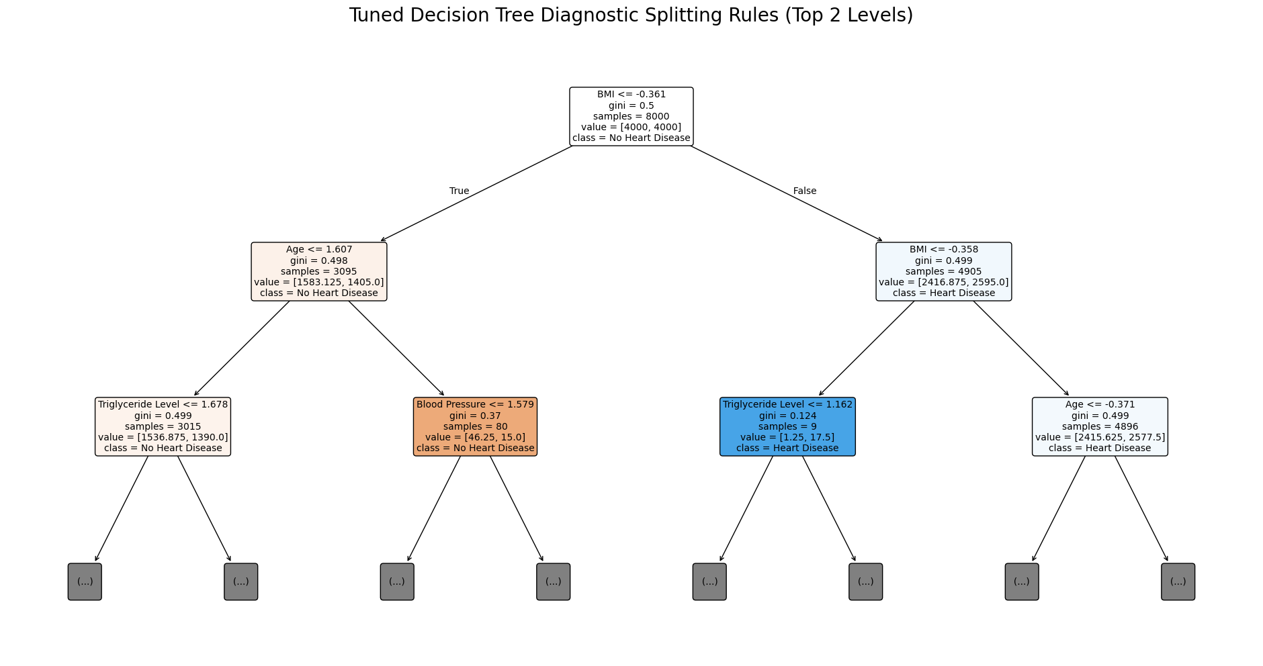
TUNED MODELS
LOGISTIC REGRESSION
DECISION TREE
RANDOM FOREST
SGD
SVM
02

Slide 9
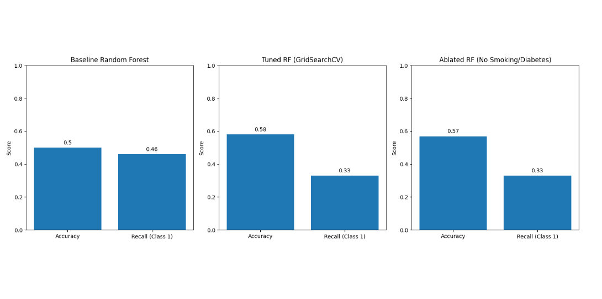
TUNED MODELS
LOGISTIC REGRESSION
DECISION TREE
RANDOM FOREST
SGD
SVM
02

Slide 10
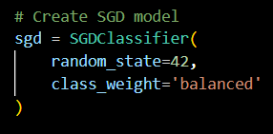
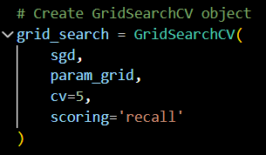
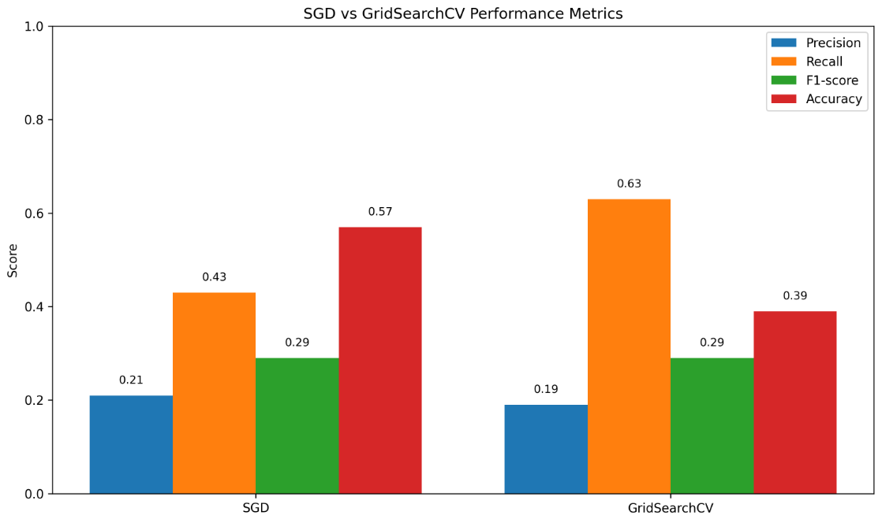
TUNED MODELS
LOGISTIC REGRESSION
DECISION TREE
RANDOM FOREST
SGD
SVM
02

Slide 11
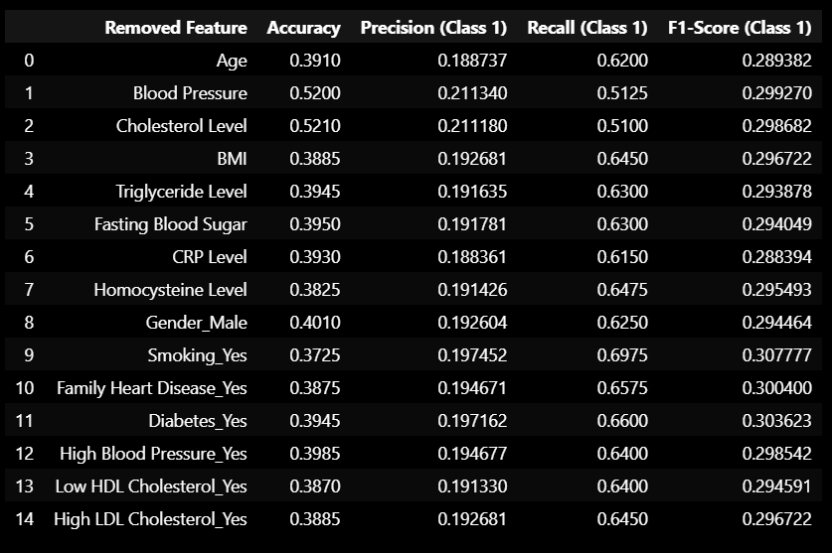
TUNED MODELS
LOGISTIC REGRESSION
DECISION TREE
RANDOM FOREST
SGD
SVM
02

Slide 12
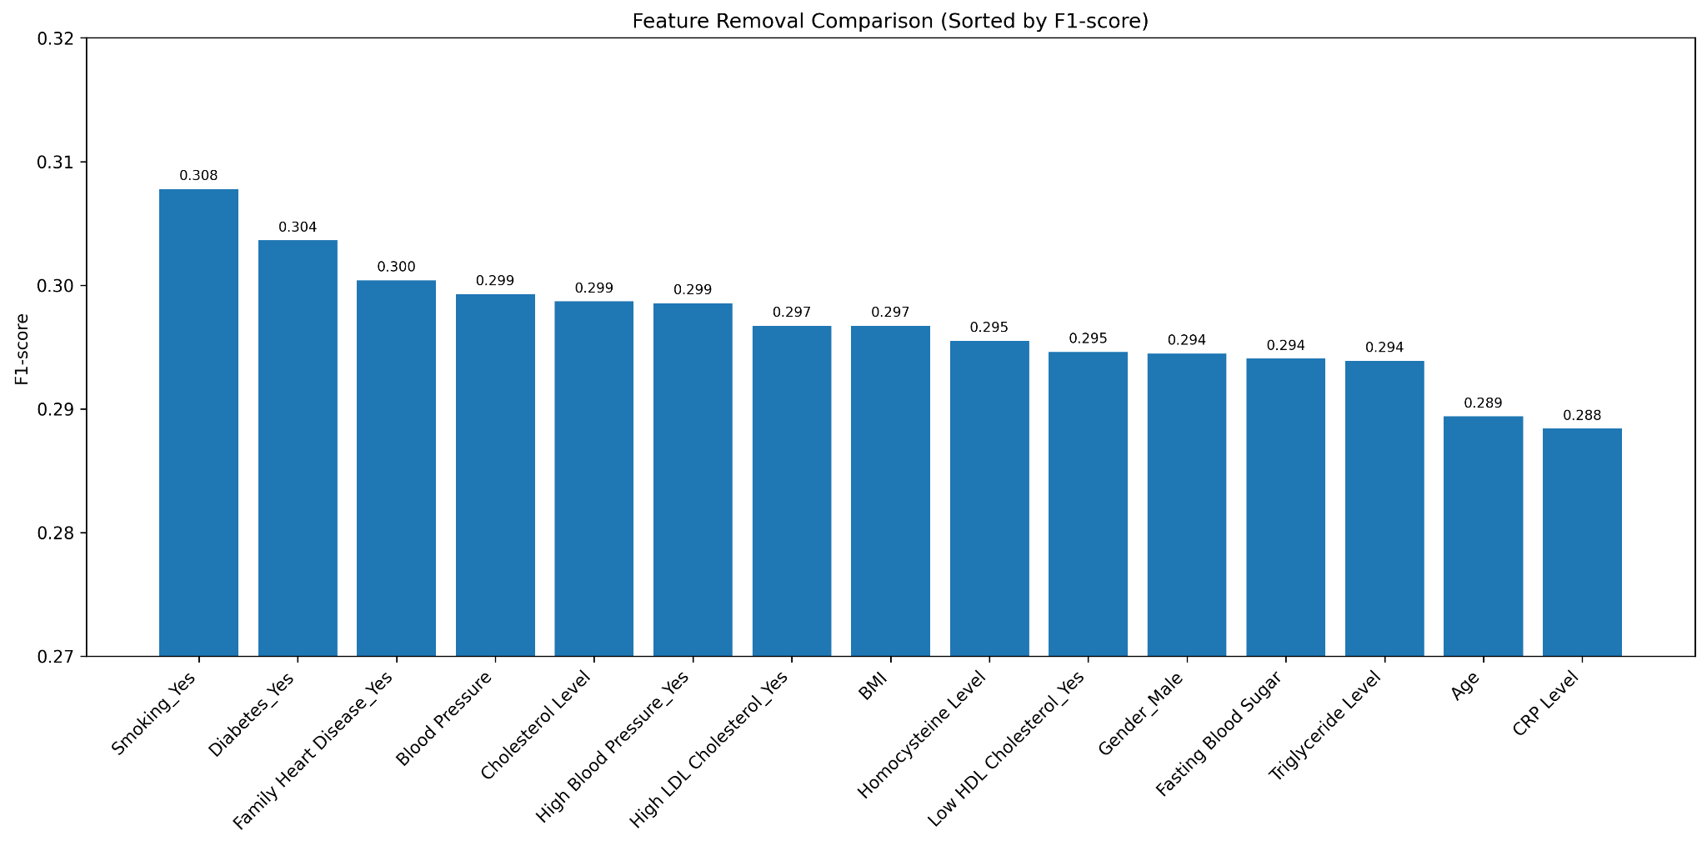
TUNED MODELS
LOGISTIC REGRESSION
DECISION TREE
RANDOM FOREST
SGD
SVM
02

Slide 13
TUNED MODELS
LOGISTIC REGRESSION
DECISION TREE
RANDOM FOREST
SGD
SVM
02

Slide 14
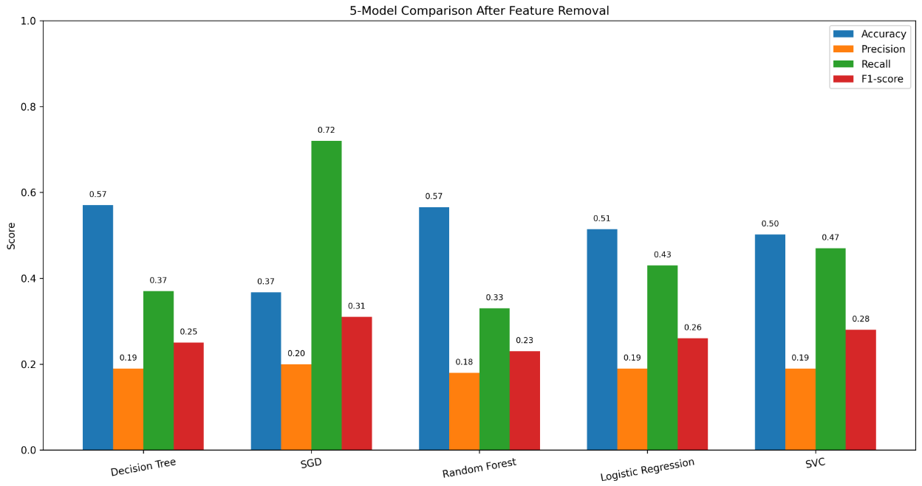
FEATURE REMOVAL
REVIEW REFINED MODEL PERFORMANCE
Drop Random Feature: smoking, diabetes
03

Slide 15
Which ML approaches fits our disease prediction problem the best?
Original Hypothesis:
Likely between Random Forest,
Logistic Regression, and
SVM
Term Project Approach:
Obtain understanding of dataset, EDA
Preprocess data, columns to drop, fill missing values
Split train/test data, stratify=Yes
Run baseline models & tune hyperparameters, GridSearchCV
Assess tuned models for each approach, recall
Have fun, feature ablation
Current Findings:
SGD model is giving us the best recall fit for our dataset.
SGD is best at large-scale, streaming EHR (electronic health record) data but requires extensive tuning and data preprocessing.
Opens up possibilities for future production scaling into a more complex disease detection algorithm.
NEXT STEPS
04

